Slide 1
Angular-2 Training
By Vamsee Kalyan

Slide 2
Pipe Line ( 20 Hours )
HTML Essential Training
CSS Essential Training
Type Script Essential Training
Angular-2 Essential Training
Duration : 5 Hours
Duration 5 Hours
Duration 5 Hours
Duration 5 Hours

Slide 3







Weekly 2 Classes
  Saturday – 6:30 PM (IST)
  Sunday – 6:30 PM (IST)
2 to 3 hours class
WebEx Meeting Centre
Adobe Brackets
Git Repository

Slide 4
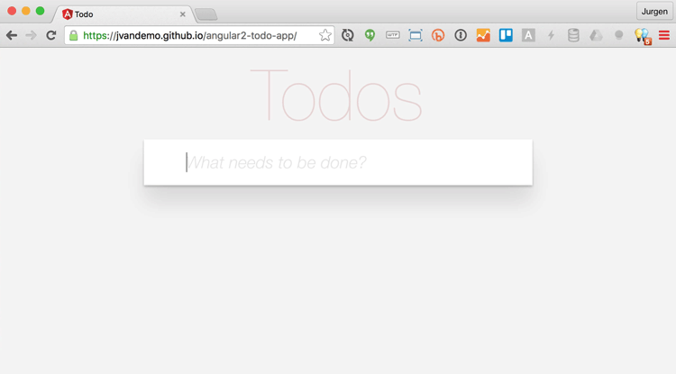
Sample Application we build by end of Training

Slide 5



Slide 6
Pavaneesh
Venkata
Sesha Reddy
Bhavana
Snigdha

Slide 7
Adobe Brackets
A modern, open source text editor that understands web design.
Brackets is a lightweight, yet powerful, modern text editor. They blend visual tools into the editor so you get the right amount of help when you want it without getting in the way of your creative process. You'll enjoy writing code in Brackets.
  Inline Editors.
  Live Preview
  Extensions

Slide 8
Git Repository
https://github.com/vamseekalyan/angular2-batch-may-2017

Slide 9
HTML Tutorial – 1st Hour
Particulars | Time
HTML Overview | 10 minutes
HTML Basic Tags | 10 minutes
HTML Elements | 10 minutes
HTML Attributes | 10 minutes
HTML Formatting | 10 minutes
HTML Phrase Tags | 10 minutes

Slide 10
HTML Tutorial – 2nd Hour
Particulars | Time
HTML Meta Tags | 10 minutes
HTML Comments | 10 minutes
HTML Images | 10 minutes
HTML Text Links | 10 minutes
HTML Image Links | 10 minutes
HTML Email Links | 10 minutes

Slide 11
HTML Tutorial – 3rd Hour
Particulars | Time
HTML Tables 1 | 10 minutes
HTML Tables 2 | 10 minutes
HTML Tables 3 | 10 minutes
HTML Lists 1 | 10 minutes
HTML Lists 2 | 10 minutes
HTML Lists 3 | 10 minutes

Slide 12
HTML Tutorial – 4th Hour
Particulars | Time
HTML Forms | 10 minutes
HTML Forms | 10 minutes
HTML Forms | 10 minutes
HTML Forms | 10 minutes
HTML Frames | 10 minutes
HTML Iframes | 10 minutes

Slide 13
HTML Tutorial – 5th Hour
Particulars | Time
HTML Embed Multimedia | 10 minutes
HTML Header | 10 minutes
Question Hour 1 | 10 minutes
Question Hour 2 | 10 minutes
Question Hour 3 | 10 minutes
HTML Style Sheet | 10 minutes

Slide 14
CSS Tutorial – 1st Hour
Particulars | Time
CSS - Introduction | 10 minutes
CSS – Syntax | 10 minutes
CSS – Inclusion | 10 minutes
CSS - Measurement Units | 10 minutes
CSS – Colours | 10 minutes
CSS – Backgrounds | 10 minutes

Slide 15
CSS Tutorial – 2nd Hour
Particulars | Time
CSS - Fonts | 10 minutes
CSS – Text | 10 minutes
CSS – Images | 10 minutes
CSS – Links | 10 minutes
CSS – Tables | 10 minutes
CSS – Borders | 10 minutes

Slide 16
CSS Tutorial – 3rd Hour
Particulars | Time
CSS – Margins | 10 minutes
CSS – Lists | 10 minutes
CSS – Padding | 10 minutes
CSS – Cursors | 10 minutes
CSS – Dimension | 10 minutes
CSS – Scrollbars | 10 minutes

Slide 17
CSS Tutorial – 4th Hour
Particulars | Time
Bootstrap Introduction | 10 minutes
Bootstrap - Grid System | 10 minutes
Bootstrap - Forms | 10 minutes
Bootstrap - Buttons | 10 minutes
Question Hour 1 | 10 minutes
Question Hour 2 | 10 minutes

Slide 18
Type Script Tutorial – 1st Hour
Particulars | Time
TypeScript - Overview | 10 minutes
TypeScript - Environment Setup | 10 minutes
TypeScript - Basic Syntax | 10 minutes
TypeScript – Types | 10 minutes
TypeScript – Variables | 10 minutes
TypeScript - Operators | 10 minutes

Slide 19
Type Script Tutorial – 2nd Hour
Particulars | Time
TypeScript - Decision Making | 10 minutes
TypeScript – Loops | 10 minutes
TypeScript – Functions | 10 minutes
TypeScript – Numbers | 10 minutes
TypeScript – Strings | 10 minutes
TypeScript - Arrays | 10 minutes

Slide 20
Type Script Tutorial – 3rd Hour
Particulars | Time
TypeScript – Tuples | 10 minutes
TypeScript – Union | 10 minutes
TypeScript – Interfaces | 10 minutes
TypeScript – Classes | 10 minutes
TypeScript – Objects | 10 minutes
TypeScript - Namespaces | 10 minutes

Slide 21
Type Script Tutorial – 4th Hour
Particulars | Time
TypeScript – Modules | 10 minutes
TypeScript – Ambient | 10 minutes
Question Hour 1 | 10 minutes
Question Hour 2 | 10 minutes
Question Hour 3 | 10 minutes
Question Hour 4 | 10 minutes

Slide 22
Angular 2 Tutorial – 1st Hour
Particulars | Time
Angular 2 – Overview | 10 minutes
Angular 2 – Overview | 10 minutes
Angular 2 – Environment | 10 minutes
Angular 2 – Environment | 10 minutes
Angular 2 - Hello World | 10 minutes
Angular 2 - Architecture | 10 minutes

Slide 23
Angular 2 Tutorial – 2nd Hour
Particulars | Time
Angular 2 – Architecture | 10 minutes
Angular 2 – Modules | 10 minutes
Angular 2 – Components | 10 minutes
Angular 2 – Templates | 10 minutes
Angular 2 – Metadata | 10 minutes
Angular 2 - Data Binding | 10 minutes

Slide 24
Angular 2 Tutorial – 2nd Hour
Particulars | Time
Angular 2 - Data Display | 10 minutes
Angular 2 - User Input | 10 minutes
Angular 2 – Forms | 10 minutes
Angular 2 – Forms | 10 minutes
Angular 2 - Forms | 10 minutes
Angular 2 - Forms | 10 minutes

Slide 25
Angular 2 Tutorial – 3rd Hour
Particulars | Time
Angular 2 - Services | 10 minutes
Angular 2 - Directives | 10 minutes
Angular 2 - Dependency Injection | 10 minutes
Question Hour 1 | 10 minutes
Question Hour 2 | 10 minutes
Question Hour 3 | 10 minutes

Slide 26
Angular 2 To-do App – 4th Hour
Particulars | Time
Development server | 10 minutes
Code scaffolding | 10 minutes
Build | 10 minutes
Running unit tests | 10 minutes
Running end-to-end tests | 10 minutes
Question Hour 1 | 10 minutes

Slide 27
Angular 2 Architecture
Directive
Component
Service { }
Class { }
Metadata ()
Class { }
Metadata ()
Dependency Injection
Injector
Template
Routing
Component-1
Component-2

